Slide 1

Welcome to CSE 373
Why data structures and algorithms, the manner in which learning occurs, and a first-look at the technical foundations.
Kevin Lin, with thanks to many others.
Notes:
Ask questions anonymously on Piazza. Look for the pinned Lecture Questions thread.
Each week, there will be scaffolded lecture handouts with whitespace for note-taking like this one. Towards the end of this handout, there are some questions associated with each slide to help guide your thinking. These handouts won’t be collected, and I encourage you to jot down whatever notes benefit you. I’ll suggest some learning practices that work best for this course in about 20 minutes.

Slide 2
Data Structures and Algorithms
A way of organizing, storing, accessing, and updating a set of data
A series of precise instructions guaranteed to produce a certain answer

Slide 3

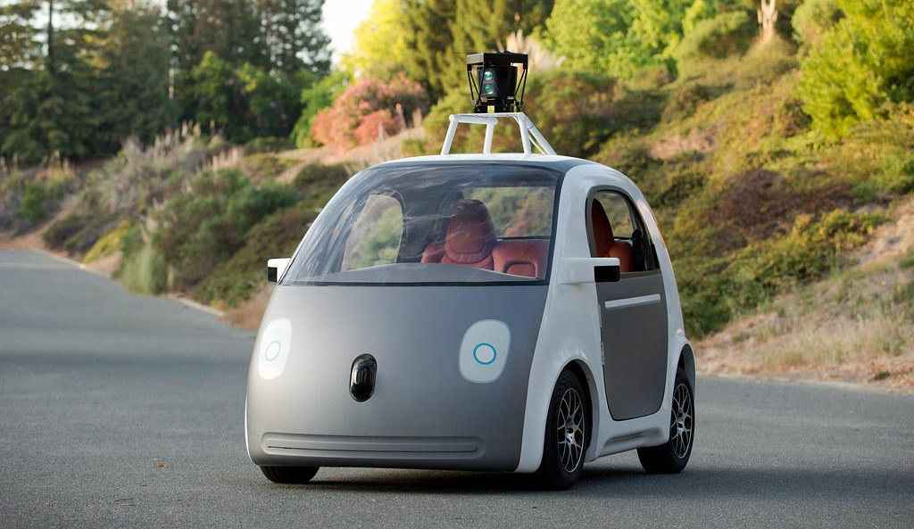

Drive current progress (?) in society
Self-Driving Car (Waymo/Google), Delivery Drone (Hadas Bendel/Wikimedia)

Slide 4
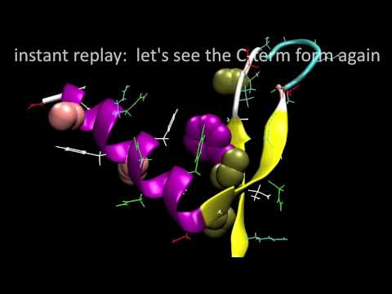

Discover new knowledge and advance the sciences
Simulation of millisecond protein folding (Voelz, Bowman, Beauchamp, Pande/Pande Lab), TIMELAPSE OF THE FUTURE: A Journey to the End of Time (melodysheep/YouTube)

Slide 5
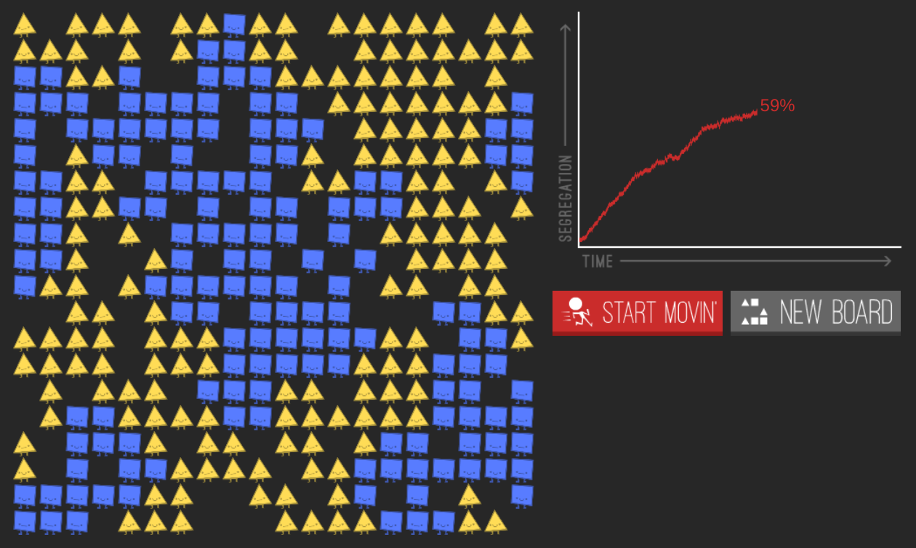
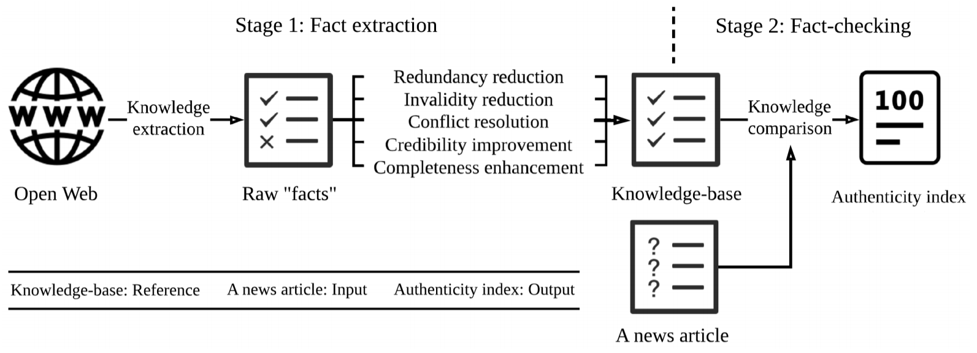
Discover new knowledge and advance the sciences
Parable of the Polygons (Vi Hart, Nicky Case); Fake News: A Survey of Research, Detection Methods, and Opportunities (Xinyi Zhou, Reza Zafarani/arXiv:1812.00315)

Slide 6
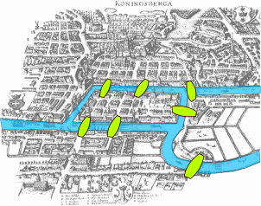
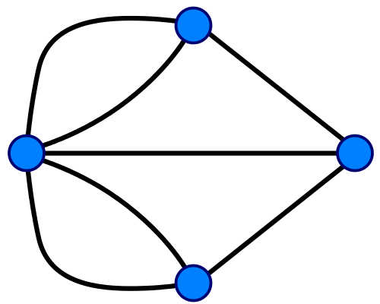
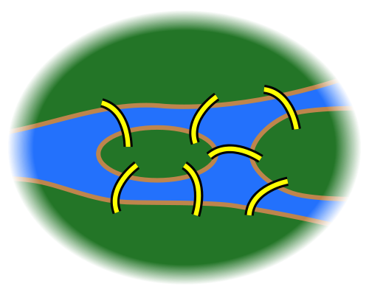
Understand different disciplines and problems in CS
Konigsberg Bridges (Bogdan Giuşcă/Wikimedia), Diagram of Seven Bridges (Chris Martin/Wikimedia), Konigsberg Graph (Riojajar~commonswiki/Wikimedia)

Slide 7
Support daily life
How to search the internet
About 7,470,000,000 results (0.60 seconds)

Slide 8
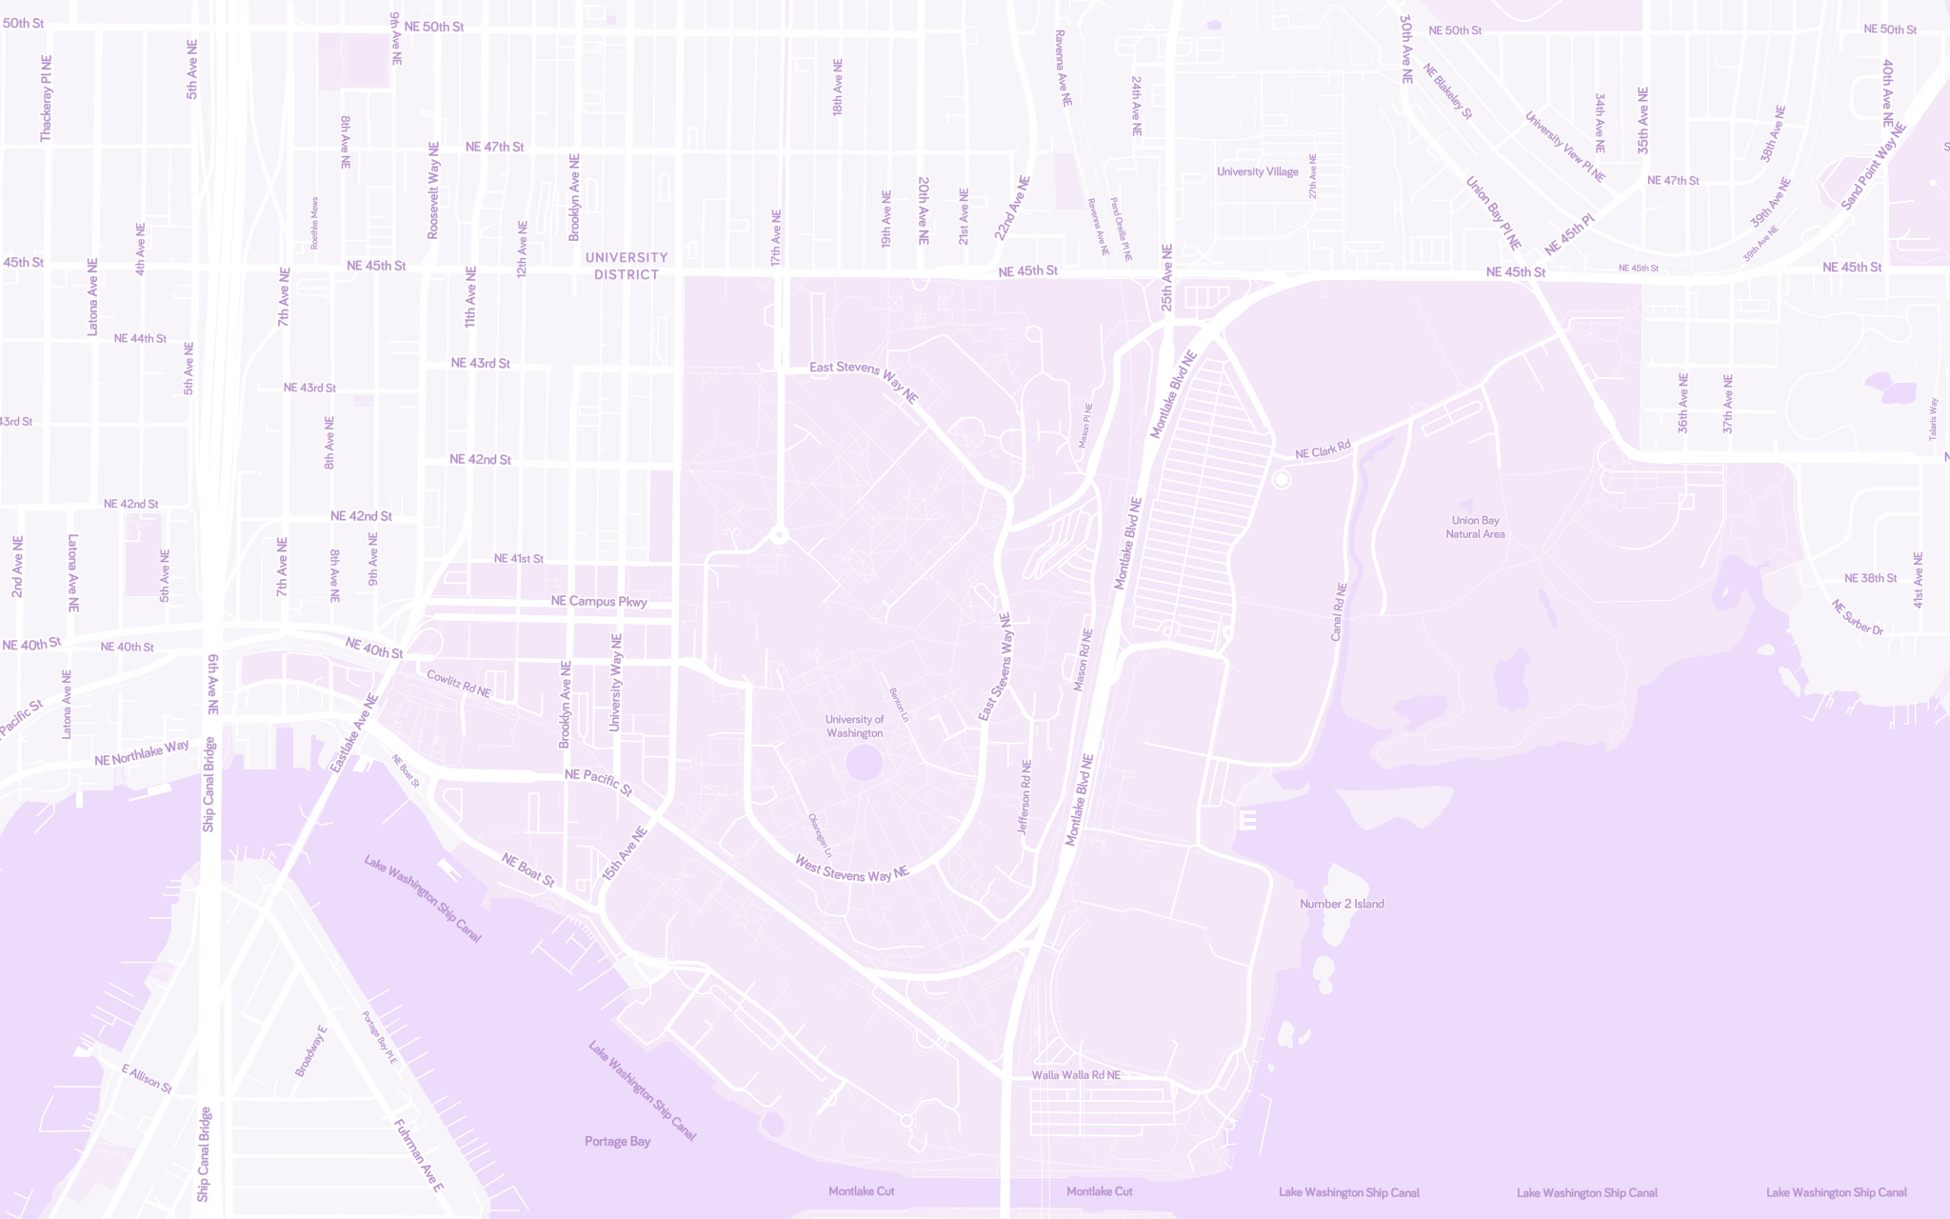

Support daily life
Demo
© Mapbox; © OpenStreetMap; Improve this map.

Slide 9
HuskyMaps
Search HuskyMaps ︙
Autosuggest
Navigation Directions
Coordinating places, locations, and map data
© Mapbox; © OpenStreetMap; Improve this map.

Slide 10
Writing code that runs efficiently
Writing code efficiently
© Mapbox; © OpenStreetMap; Improve this map.

Slide 11
Course Overview
Today
2 weeks from now
8 weeks from now
Winter Break
HuskyMaps
Software Development
Problems in the Real World

Slide 12
What do you hope to learn in CSE 373?
Becoming a better programmer.
Using data for good.
Becoming coding interviewer.
Competitivity and becoming a better learner.
Building larger programs.

Slide 13
Writing code that runs efficiently
Writing code efficiently
Processes

Slide 14
The Manner in Which Learning Occurs (TMWLO)
… is through metacognition, e.g. asking questions about your solution process.
Explain to yourself why you’re making this change to your program while debugging.
Make an explicit prediction of what you expect to see before you run your program.
Be aware when you’re not making progress on a code writing or debugging task, so you need to take a break or try a different strategy.
Explain the tradeoffs with using a different data structure or algorithm. If one or more requirements change, how would the solution change as a result?
Reflect on how you ruled out alternative ideas along the way to a solution.
State the learning goals for the problem and its relationship to other ideas in the course.
In Defense of Continuous Exposition by the Teacher: Definitions of “Lecture” and “Active Learning” (Mark Guzdial/Computing Education Research Blog)
Notes:
Here’s the note-taking strategy that I think works best for this course (once we get to the technical content).
Jot down any questions, insights, or realizations that come to mind. See the above questions to get started.
Jot down the relationships between new ideas and old ideas. How does a new piece of information strengthen, weaken, or otherwise complicate earlier ideas?
Sketch visualizations of your mental diagrams and small examples. What general principles or patterns seem to govern the visualizations or examples?
I see active thinking and engagement as being the most important part of learning, with note-taking as a means to this end. Give this strategy a try, but do what helps you learn the best.
?: How do your own learning strategies (in, say, previous courses) compare to this metacognitive approach?

Slide 15

Real world analogues
Minimal working example
Rubber duck debugging
Scientific method
Rubber duck assisting with debugging (Tom Morris/Wikimedia)
Notes:
Experienced programmers can sometimes seem to solve problems almost intuitively because of how much practice they've had getting unstuck. While they get stuck just as often as you or me, they’ve exercised their problem-solving muscle enough to have an idea of which debugging strategy to try next. This learning doesn’t come immediately: it takes a lot of practice to develop these metacognitive skills.

Slide 16
Basic Learning Workflow
Least
Comfort with a topic
Most
Office Hours
Lecture, Quiz Section
Studying, Homework, Guerrilla Section
Next week’s QuickCheck
Notes:
This is the barebones (sad) version of CSE 373. We’ll talk about a better learning workflow soon.

Slide 17
cs.uw.edu/373
Everything is posted to the course website
Notes:
Course schedule, policies, and staff introductions. The course website is your one-stop shop, but you’ll also receive major announcements via Piazza email notifications.

Slide 18
Learning
Community
Course Staff
Notes:
Regardless of whether you want to work in industry, academia, non-profits, or contribute to the world in another way, any project of interesting scale will involve other people. Part of the experience of this course is about engaging productively with members of the course community.

Slide 19
You
Notes:
The reality is that learning is not so simple that we’ll always feel comfortable with a topic even after seeing it in class, working through it in section, and solving problems on the homework. It’s important to have a study partner or group for this reason, but also to improve the efficiency of your learning. Efficiency matters because the most precious and limited resource in this course is your 120 hours of attention divided over 10 weeks. It’s important to make the most of those hours.

Slide 20
TMWLO, CSE 373 Edition
Least
Comfort with a topic
Most
Office Hours
Studying, Homework, Guerrilla Section
Lecture, Quiz Section
Regular Group Meeting
Study Partner/Group
QuickCheck Study Guide
Direct preparation for exam problems
Next week’s QuickCheck
Notes:
Protip 1. For the regular group meeting, pick a time that overlaps with office hours so that if you’re stuck your entire group can discuss in office hours without having to reschedule.
Protip 2. Office hours around assignment due dates like Tuesday tend to be crowded.

Slide 21
Limits of collaboration
Do not claim to be responsible for work that is not yours.
We really do catch people who violate the rule, because:
We also know how to search the internet for solutions.
We use data structures and algorithms to check your work.
All code you submit should be your own work, with a few permissions:
Receiving significant conceptual ideas towards a solution.
Using small snippets of code that you find online for solving tiny problems.
These must be cited with comments in your code.

Slide 22
Collaboration is strongly encouraged
Discuss everything with each other. Teaching is the best way to learn!
Form study groups with your peers in lecture, quiz section, or group study.
Final grades are not curved, i.e. they are not based on your relative performance.
Effort Attending office hours, making progress on every homework, reading Piazza
Participation Engaging in discussion in lecture or section, asking Piazza questions
Altruism Helping other students, answering Piazza questions
EPA is optional and can provide a slight grade boost.

Slide 23
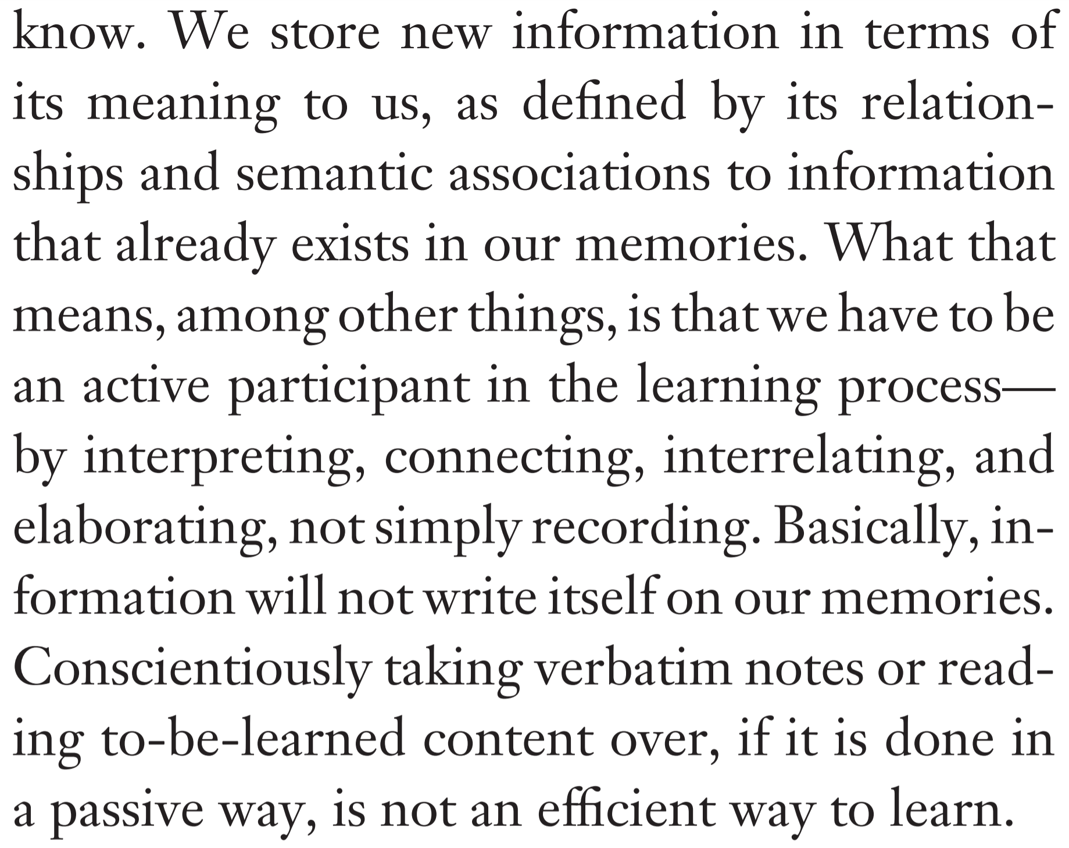
TMWLO, CSE 373 Edition
programming is [...] fundamentally about the iterative process of refining mental representations of computational problems and solutions and expressing those representations as code
Programming, Problem Solving, and Self-Awareness: Effects of Explicit Guidance (Loksa et al./CHI ‘16); Self-Regulated Learning: Beliefs, Techniques, and Illusions (Bjork, Dunlosky, Kornell/Annual Review of Psychology 2013)
Notes:
The average human can only hold 7 ± 2 chunks of information in their working memory. One of the meta-challenges for learning in this course is determining what chunks make the most most effective use of that space: which mental representations best model a particular problem. Learning happens when you refine and update your mental representations, so we should embrace the mistakes we make along the way. That’s when we know learning is happening.

Slide 24
A student suggestion
Notes:
WORKING WITH A FRIEND. This is in caps because I think it is so so important and worked so so well for me. I want to add that it is best if this friend is about at the same level as you (with respect to grades or intellect or however I should say that). Often, we’d both be stuck on a problem. I’ve seen people studying alone sit and stare at the solution trying to make sense of it, or post on Piazza. But my friend and I often just went with “well, obviously the answer key must be right. So let’s try to figure it out”. And we did. We came up with a fool-proof algorithm for how to know if adding a node with change the original MST, came up with tricks to figure out which sorting gets assigned to which column, etc. Also, it’s best if this person is someone you’re close to. My friend and I often told each other straight up “nah that’s definitely not going to work”. I find it difficult being this straightforward with an acquaintance. Also we weren’t embarrassed of throwing completely bizarre ideas at each other, provided we started it off with “I have no idea if this leads to anything, but…”
In short, this course is all about asking questions–to yourself, to your peers, to the staff–about what you’re thinking, how you arrived at that moment of thinking, and how that thinking complicates your understanding of previous ideas.

Slide 25
Abstract Data Types
Notes:
All programs work with data in one way or another. A function takes input data (arguments) and transforms them into some output data (return value). How we organize this data governs the way we write programs.
There are a lot of questions in the note space for the first few lectures. Think of them as a tool to guide your thinking rather than questions that need to be answered concretely or written down.

Slide 26
Data Types
A variable’s data type (or simply type) determines its possible values and operations.
int course;
course = 37;
course = -37;
String course;
course = "37";
course = "-37";
Possible values
course = 3.14;
course = "3.14";
Possible operations
(37 + 3) == 40
("37" + "3").equals("373")
course.equals(37)
Cannot call equals
Notes:
?: What is an example of an impossible value for String?
?: What is an example of an impossible operation for String?

Slide 27
Interfaces vs. Implementations
In Java, an interface is a data type that specifies what to do but not how to do it.
List: a collection storing an ordered sequence of elements.
A subtype of List must implement all methods required by the List interface.
ArrayList: Resizable array implementation of the List interface.
LinkedList: Doubly-linked implementation of the List interface.
List
ArrayList
LinkedList
Notes:
Data types determine possible values and operations.
?: What differentiates interfaces from int and String data types?
?: In Java, how do we declare that ArrayList is a subtype of the List interface?
?: What does Java do to check that ArrayList is indeed a subtype of the List interface?

Slide 28
Abstract Data Types (ADTs)
Java interfaces represent the software design concept of abstract data types.
An abstract data type is a data type that does not specify any one implementation.
Data structures implement ADTs.
Resizable array can implement List, Stack, Queue, Deque, PQ, etc.
Linked nodes can implement List, Stack, Queue, Deque, PQ, etc.
List ADT. A collection storing an ordered sequence of elements.
Each element is accessible by a zero-based index.
A list has a size defined as the number of elements in the list.
Elements can be added to the front, back, or any index in the list.
Optionally, elements can be removed.
Notes:
?: What’s the difference between interfaces and ADTs?
?: What are the practical benefits of separating behavior (ADT) from implementation (data structure)?
?: Why not just use ArrayList all the time?

Slide 29
Hiding Program Complexity
Q
Abstract data types hide implementation details from clients (users of ADTs).
This kind of abstraction is a powerful and recurring software design principle.
See also: the Internet architecture.
Contract: Assuming they agree to the ADT’s possible values and operations, the client and the implementer can improve their programs at the same time.
Client
ADT
Implementer
Notes:
The area of each shape in the diagram represents the relative complexity.
Q1: Describe an (imaginary) scenario where the contract does not hold. What are the consequences of breaking the contract?
Q2: Are there times when it would be useful to know the implementation details of an ADT’s values or operations? Why?
?: Beyond simply computing the correct result, what criteria make one program any better or worse than another program?

Slide 30
Design Decisions
Q
For every ADT, there are infinitely many data structures and algorithms that solve the problem.
This course will study data structures and algorithms as design decisions.
Running time, dependent on the input data.
Reusability vs. Specificity.
Robustness vs. Performance.
By evaluating, implementing, and defending designs, we become better computer scientists.
Notes:
Practice with the List ADT coming up in section.
Extra Design Question: Dub Street Burgers is implementing a new system for ticket (i.e. food order) management. When a new ticket comes in, it is placed at the end of the line of tickets. Food is prepared in about the order requested, but some food orders take less time to prepare than others. As a result, some tickets may be fulfilled earlier than other tickets.
Let’s represent tickets as a list. Should we use an ArrayList or a LinkedList? Why?

